Slide 1
Human Immunodeficiency virus (HIV)

Slide 2
Etiologic agent of Acquired Immunodeficiency Syndrome (AIDS).
Discovered independently by Luc Montagnier of France and Robert Gallo of the US in 1983-84.
Former names of the virus include:
Human T cell lymphotrophic virus (HTLV-III)
Lymphadenopathy associated virus (LAV)
AIDS associated retrovirus (ARV)

Slide 3
Leading cause of death of men aged 25-44 and 4th leading cause of death of women in this age group in the US.

Slide 4
Acquired immunodeficiency syndrome (AIDS) was first described in USA (1981).
HIV virus is the causative agent of AIDS which infect and destroys helper T cells (CD₄) leading to number of immunological deficiencies. HIV falls under retroviridae family and lentivirinae sub-family.

Slide 5
H – Human – This particular virus can only infect human beings.
I – Immunodeficiency – HIV weakens your immune system by destroying important cells that
fight disease and infection. A "deficient" immune system can't protect you.
V – Virus – A virus can only reproduce itself by taking over a cell in the body of its host.

Slide 6
A – Acquired – AIDS is not something you inherit from your parents. You acquire AIDS after birth.
I – Immuno – Your body's immune system includes all the organs and cells that work to
fight off infection or disease.
D – Deficiency – You get AIDS when your immune system is "deficient,"
or isn't working the way it should.
S – Syndrome – A syndrome is a collection of symptoms and signs of disease. AIDS is a syndrome,
rather than a single disease. It is a complex illness with a wide range of symptoms.

Slide 7
General properties/Morphology
HIV is enveloped ds RNA virus, approximately 100nm icosahedral structure (20 sided) with 72 external spikes that are formed by the two major envelope glycoproteins gp120 and gp41. The mature virion is composed of a central core surrounded by a spherical lipid envelope. The core contains reverse transcriptase, integrase and protease in association with two strands of RNA. HIV has a long genome with at least 9 genes.( tat, rev, vif, vpu, vpr, nef, gag, pol, env)

Slide 8
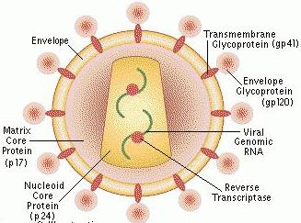
Fig: structure of HIV virus

Slide 9
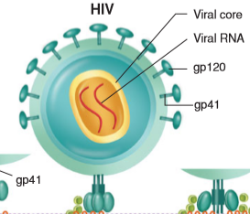

Slide 10
There are 2 types of HIV. HIV-1 is predominant worldwide whereas HIV-2 is common in Africa. HIV-2 discovered in 1986, antigenically distinct virus endemic in West Africa.
Around 33.2 million people are living with HIV/AIDS worldwide with worst affected areas like sub-Saharan Africa followed by south east Asia. HIV/AIDS in Nepal was first reported in 1988 and since then more than 70,000 are infected.

Slide 11
HIV-1 vs. HIV-2
HIV-1
More virulent
Responsible for worldwide epidemic
Severity of infection varies from person to person
HIV-2
Primarily found in western Africa
Not transmitted as efficiently
Genome more closely related to SIV_{mm} than HIV-1
Notes:
Simian immunodeficiency virus

Slide 12
HIV Antigens
Major surface/envelope glycoproteins
gp120
gp41 anchors gp120 to virus
Major capsid proteins
p24
P18
Other minor surface & structural proteins
p55

Slide 13
Mode of transmission
HIV is transmitted through blood, semen, vaginal fluid and from an infected mother to her child.
Unprotected sex (oral, anal or vaginal)
Sharing of contaminated needles (piercing, tattooing, injecting drugs)
Unsafe blood transfusion
Use of improperly sterilized hospital tools
Mother to child transmission- during pregnancy and breast feeding

Slide 14
Pathogenesis/clinical manifestation
1.Primary stage/acute infectious stage
After the virus enters the body, the virus infects CD₄ T cells, macrophages and other cells due to which there is increase in concentration of virus in the blood. Approximately 50% of individual will develop a febrile, flu like illness along with swollen glands, rash, oral ulcers, headache, diarrhoea, nausea and vomitting. CD4+ count is normal. Infected person can infect other people.
During this period, no antibody can be detected in the blood and this interval period between HIV infection and appearance of antibodies in serum is called “window period”. Window period is of about 2-3 weeks (maximum 6 weeks). However a patient in window period can transmit the virus. Primary infection resolves within weeks as the body mounts HIV specific adaptive immune response and the patients enters clinical latency.

Slide 15
2.Assymptomatic phase
HIV infected patients remain asymptomatic (clinically latent) for a variable period of time often 10-15 years. Though virus replicates, it is lowered by humoral and cellular immunity. The level of HIV in the blood drops to low levels
HIV antibodies are detectable in the blood However the patients remain infectious and transmit the virus to others. There is gradual decline in circulating CD₄ T cells and increase in HIV viral load and often no symptom is seen in this phase. However infants infected with HIV develop symptoms soon after the primary infection, often within a few months.

Slide 16
3.Symptomatic/AIDS condition
In this stage, there is decrease in CD4 T cells that leads to immune suppression. Due to lowering of immune system the patients
becomes susceptible to Opportunistic Infections. If untreated, most HIV infected individuals develop AIDS and die. AIDS is the irreversible breakdown of immune defense mechanism. AIDS is characterised by when the HIV positive individual have CD₄ counts less than 200 µl of whole blood or have common opportunistic infections like candidiasis, Tuberculosis, Kaposi’s sarcoma, Pneumocystis carinii pneumonia, Cryptococciasis etc.

Slide 17
Opportunistic Infections associated with AIDS
CD₄<500
Bacterial infections
Tuberculosis (TB)
Herpes Simplex
Herpes Zoster
Vaginal candidiasis
Hairy leukoplakia
Kaposi’s sarcoma

Slide 18
CD4<200
Pneumocystic carinii
Toxoplasmosis
Cryptococcosis
Coccidiodomycosis
Cryptosporiosis
Non hodgkin’s lymphoma

Slide 19
CD4 <50
Disseminated mycobacterium avium complex (MAC) infection
Histoplasmosis
CMV retinitis
CNS lymphoma
Progressive multifocal leukoencephalopathy
HIV dementia

Slide 20
TB & HIV CO-INFECTION
TB is the most common opportunistic infection in HIV and the first cause of mortality in HIV infected patients (10-30%)
10 million patients co-infected in the world.

Slide 21
Immunologic Manifestations
Early stage slight depression of CD₄ count, few symptoms, temporary.
Window of up to 6 weeks before antibody is detected, by 6 months 95% positive.
During window p24 antigen present, acute viremia and antigenemia.

Slide 22
Laboratory diagnosis
Virus isolation: HIV can be cultured from lymphocytes(occasionally from other specimens) in the pheripheral blood.
2.Serological test
An antigen/antibody test performed by a lab on blood from a vein can usually detect HIV 18 to 45 days after exposure.
-ELISA test ( It detects antibodies to HIV and is used for routine screening)
-western blot ( it is the confirmatory test for HIV infection)
-Rapid test ( rapid tests are simple, inexpensive and results are obtained within 30 minutes, though this test is less sensitive than ELISA)
3. Non specific test: The following parameters are used to detect immunodeficiency and to monitor therapeutic response.
-Blood count, Lymphocyte count, T cell subset assay, hypergammaglobulinaemia, tuberculin tests etc.

Slide 23
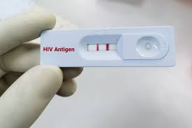
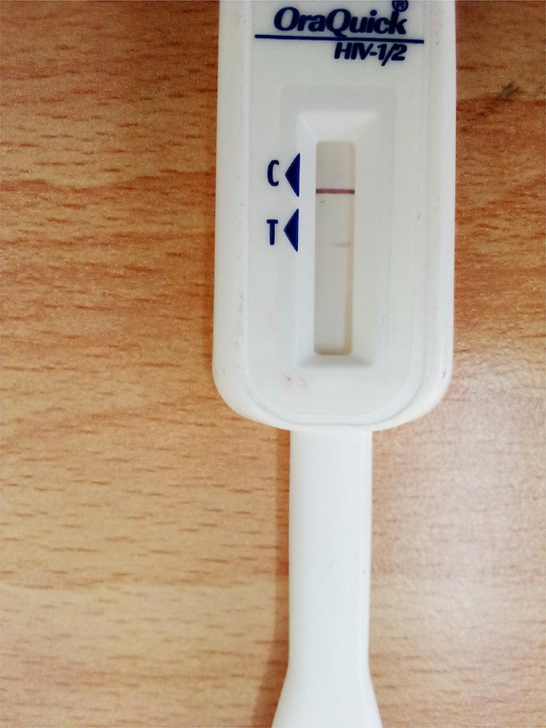

Slide 24
Laboratory Diagnosis
Test
Serology
ELISA
Latex Agglutination
Western Blot
Immunofluorescence
Virion
RNA, RT-PCR
P24 antigen
Isolation of virus
Lymphocyte
CD4:CD8 T cell ratio
Objective
Initial Screening
Initial Screening
Confirmatory test
Confirmatory test
Detection of virus in blood
Early marker of infection
Test not readily available
Correlate of HIV Disease

Slide 25
-Non-specific tests for HIV
Blood counts
Leucopenia
Lymphocyte count less than 400/cmm
Thrombocytopenia
T-cell subset assay
CD4 count below 200/cmm
Normal CD4:CD8 ratio 2:1. Reversed in AIDS to 0.5:1.
Hypergammaglobulinaemia
Diminished CMI – Candidial, tuberculin tests.
Lab diagnosis of opportunistic infections
Malignancies

Slide 26
ELISA Testing
First serological test developed to detect HIV infection.
Easy to perform.
Easily adapted to batch testing.
Highly sensitive and specific.
Antibodies detected in ELISA include those directed against: p24, gp120, gp160 and gp41, detected first in infection and appear in most individuals

Slide 27
ELISA Testing
Different types of ELISA techniques used:
indirect
competitive
sandwich
ELISAs are for screening only, false positives do occur and may be due to AI disease, alcoholism, syphilis, and immunoproliferative diseases.

Slide 28
Western Blot
Most popular confirmatory test.
Utilizes a lysate prepared from HIV virus.
The lysate is electrophoresed to separate out the HIV proteins (antigens).
The paper is cut into strips and reacted with test sera.
After incubation and washing anti-antibody tagged with radioisotope or enzyme is added.
Specific bands form where antibody has reacted with different antigens.
Most critical reagent of test is purest quality HIV antigen.
The following antigens must be present: p17, p24, p31, gp41, p51, p55, p66, gp120 and gp160.

Slide 29
Western Blot
Interpretation of results.
No bands, negative.
In order to be interpreted as positive a minimum of 3 bands directed against the following antigens must be present: p24, p31, gp41 or gp120/160.
CDC criteria require 2 bands of the following: p24, gp41 or gp120/160.

Slide 30
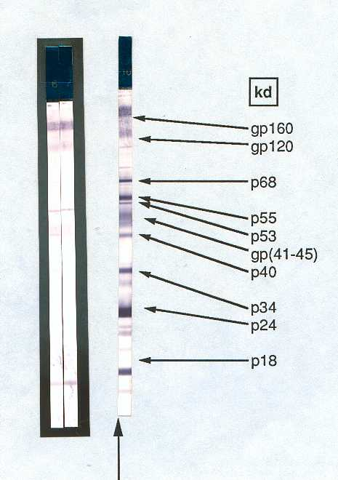
Western Blot
Expensive – $ 80 - 100
technically more difficult
visual interpretation
lack standardisation
- performance
- interpretation
- indeterminate reactions – resolution of ??
‘Gold Standard’ for confirmation

Slide 31
Other test
There are now several relatively inexpensive, rapid tests (10 to 20 minutes) available for HIV screening that are especially useful at urgent care clinics and emergency departments, as well as in developing, resource-poor countries. The tests use urine or fingerstick amounts of blood, and the OraQuick test can even use an oral swab of fluid. Some of these tests can potentially be used for home testing.

Slide 32
APTIMA assay detects the RNA of the HIV-I virus and this test can also be used to detect early HIV infections, before appearance of antibodies.
Measurement of plasma viral load (PVL) in the blood of patients and monitor the treatment and progression of AIDS.
PCR detection of viral RNA, are costly, and require 2 or 3 days to complete. Viral RNA can be detected in 7 to 10 days and, less reliably, in 2 to 4 days.

Slide 33
Prevention and control
Safe sexual contact
Health education
Use of sterilized needles for IV drug use and piercing
Screening of blood and blood products before transfusion
Control of infection-screening of high risk groups, precaution by health care professional.
Isolation and treatment of infected individuals
Preventing mother to fetus transmission

Slide 34
Treatement
No specific drugs/ therapy.
Available drugs only can help to reduce replication
Highly active antiretroviral therapy (HAART) are medications used to treat HIV. (include combination of of nucleoside reverse-transcriptase inhibitors (NRTI), non-nucleoside reverse-transcriptase inhibitor (NNRTI), protease inhibitor (PI) or integrase inhibitors (also known as integrase nuclear strand transfer inhibitors or INSTIs)
Common antiviral drugs-zydovudine, ritonavir etc.
Drugs to treat OIs(Opportunistic infections)

